Slide 1
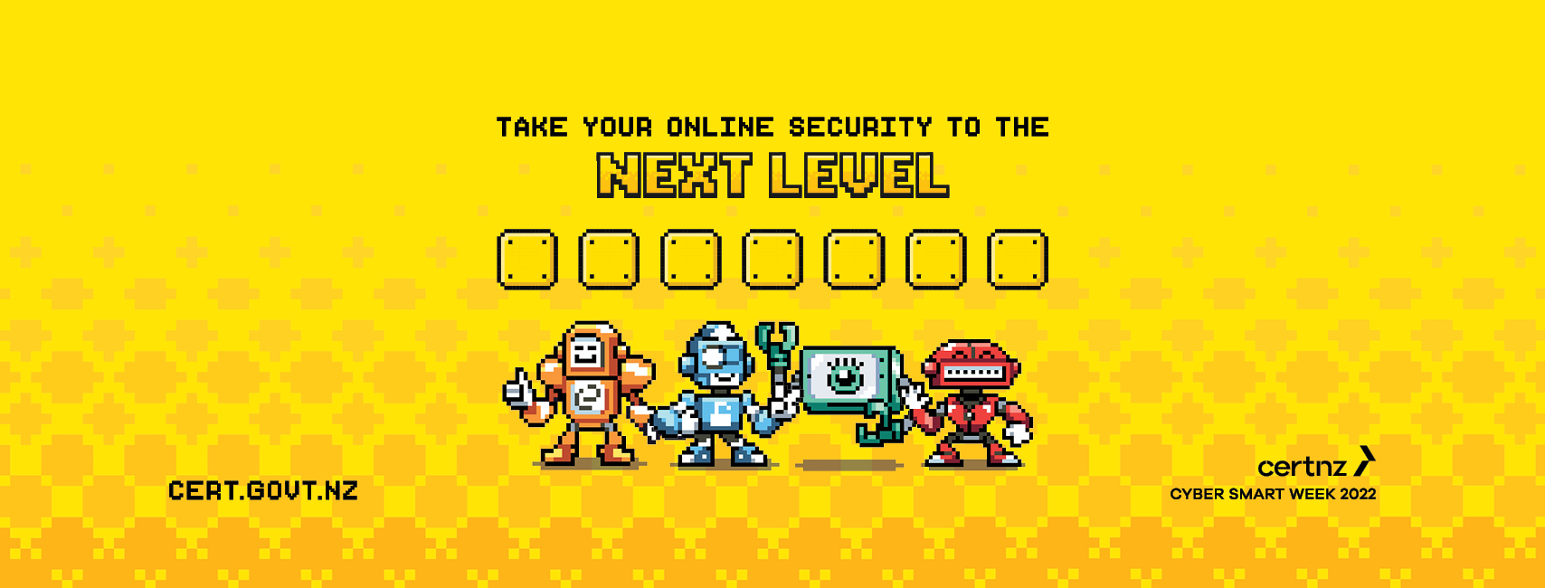
CYBER SMART WEEK 2022
Contact info@cert.govt.nz
Notes:
Aotearoa’s annual campaign helping New Zealanders be more secure online!

Slide 2
What is CERT NZ?
CERT NZ is the government agency focused on improving the cyber resilience of all New Zealanders.
The team at CERT NZ do this by making the very latest cyber security guidance and response services as easy as possible to access for all New Zealanders, at no cost.
They believe a thriving New Zealand is a cyber-secure New Zealand.
For more information, visit www.cert.govt.nz
Notes:
CERT NZ launched in 2017.
CERT NZ works both in cyber security education and awareness, as well as helping everyday New Zealanders through to large organisation respond to and recover from cyber security incidents.

Slide 3
What is Cyber Smart Week?
Cyber Smart Week is CERT NZ’s annual campaign aimed at educating New Zealanders on the simple steps they can take to reduce the risk of experiencing an online security incident
Cyber Smart Week coincides with International Cyber Security Month
10-16th October 2022
Supported by over 500 partners
Notes:
Cyber Smart Week is CERT NZ’s cornerstone campaign. First launched in 2017, It’s in its sixth year. Running 10 – 16th October.
In 2004 the President of USA announced October would be the official month for cyber security awareness. Every year, countries around the globe run cyber security education and awareness campaigns during October.
Part of Cyber Smart Week’s success is all the amazing organisations (like you) who share the messages and help New Zealanders become more capable and confident online. This year ‘our company’ is joining over 500 organisations and taking part in Cyber Smart Week, and more importantly contributing to a more cyber resilient New Zealand.

Slide 4
Why take your cyber security to the NEXT LEVEL?
Cyber security incidents are on the rise and as a results New Zealanders are losing money and personal information too.
In 2021, New Zealanders reported 8,831 incidents to CERT NZ, with more than $16 million in direct financial loss
Fortunately, there are simple steps all New Zealanders can take to significantly reduce the risk of an attack and help protect their online accounts, finance and personal information.

Slide 5
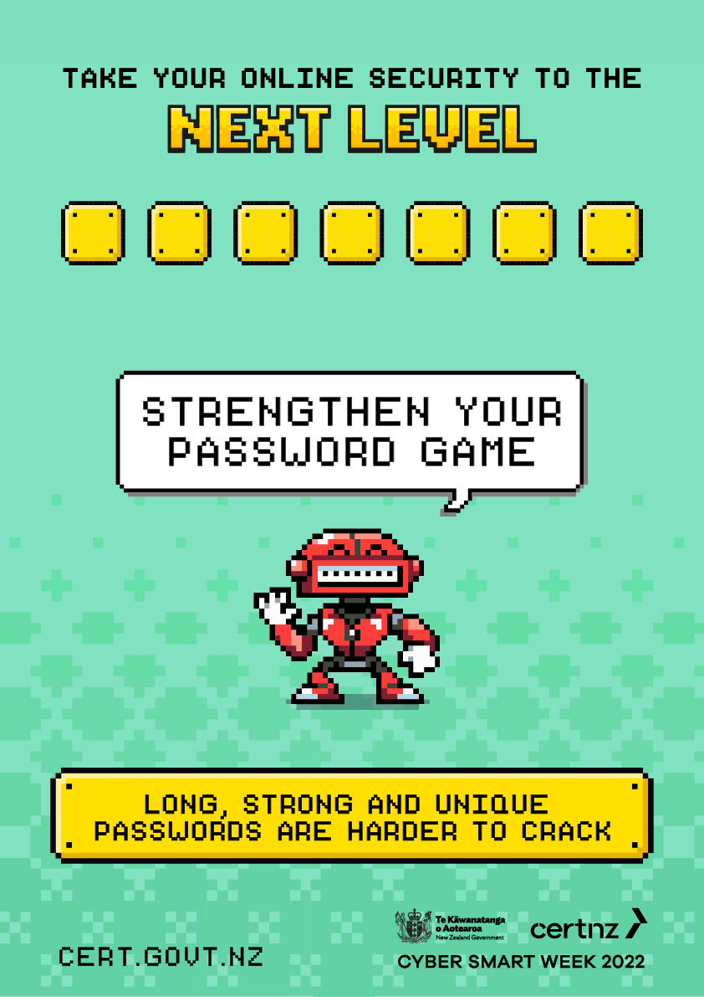
Notes:
The longer a password the stronger it is! And Use different passwords for each online account – that way if one of your passwords is exposed, your other accounts aren’t at risk
An easy way to create a good password is to make a passphrase, that’s four or more random words. Like: PopcornBestWithButter Not only are passphrases easier to remember, they’re as strong as a password that uses a long mix of numbers, letters, and symbols.A passphrase is a string of four or more random words. The more characters a password has the harder it is to crack.
Take it up another level: Keep your passwords secure, with a password manager – it’s like an online vault that keeps all your logins in one secure place. That way you online need to remember one strong password – what could be easier!?
Password Manager – LINK

Slide 6
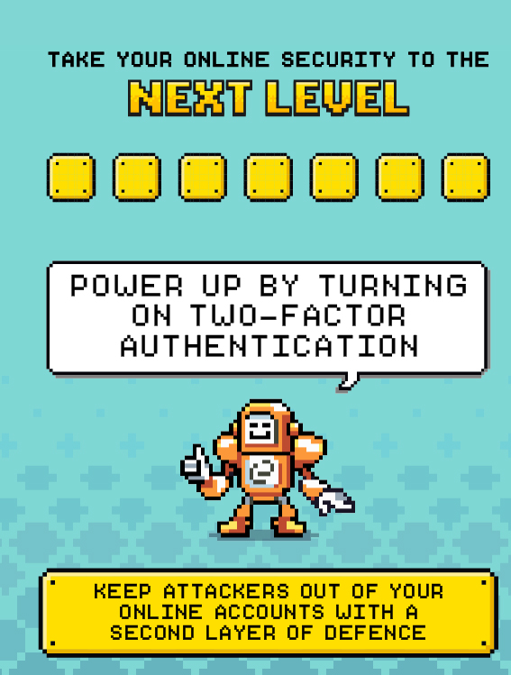
Notes:
Power up with 2FA
Keep attackers out of your online accounts with a second layer of defense. Double down and protect your online accounts from attacks with two-factor authentication (2FA). It’s like a secret key for your online accounts that’s used on top of your password. It’s usually a unique code sent to your phone or taken from an app that only you have access to. Having 2FA turned on means even if an attacker gets your login details, they still won’t get in.
Turn on two-factor authentication

Slide 7
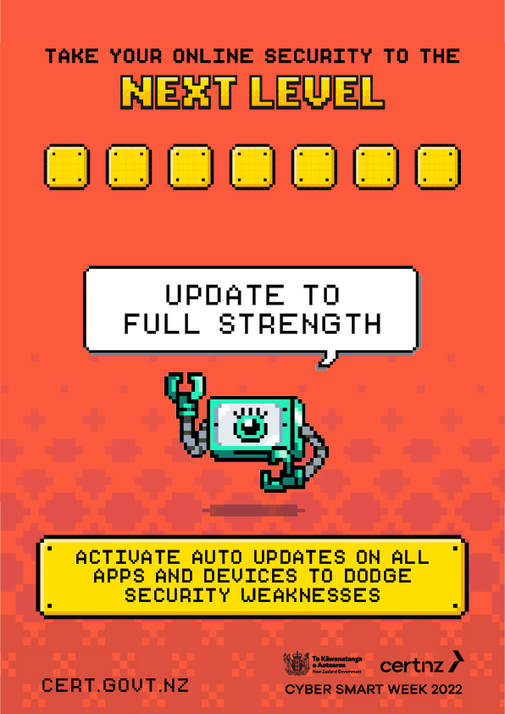
Notes:
Update to full strength
Activate auto updates on apps and devices to dodge security weaknesses. Updates help keep your apps and devices healthy. Updates aren’t just about getting the latest features available on apps and devices, they also protect you from any weaknesses that could let attackers in. The easiest way to do this is by going to settings and turning on automatic updates – then you just let it do its thing.
Update your devices and software

Slide 8
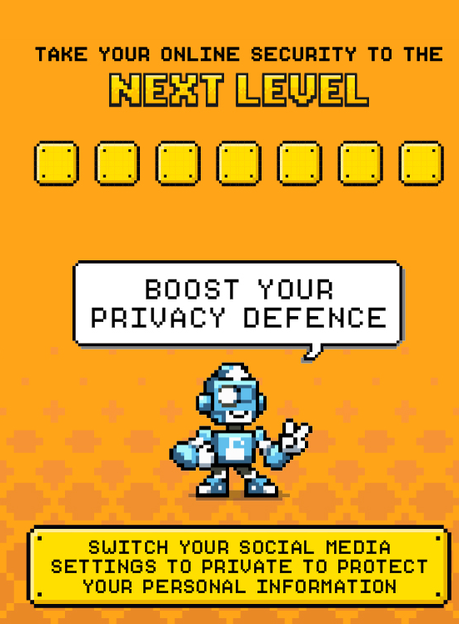
Notes:
Switch social media settings to private to protect your personal info.
Your personal information is gold for attackers. Make sure your social media settings are switched over to ‘Private’ or ‘Friends only’ – this way, you can control who sees what information you share and who you’re sharing it with. This not only protects yourself, but also your friends, family and followers from scams.
Protect your privacy
Many people might not realise but your social media profiles contains information that is valuable to attackers. They can use this information to try and guess your passwords, imitate you online or try and trick your friends and family. Making sure you keep your accounts so only people you know see what you share you are reducing the risk of experiencing a online security incident.

Slide 9
Report it
www.cert.govt.nz/report
Notes:
If you think you’ve been impacted by a cyber security incident, report it to CERT NZ, they incident response team will help you identify the issue and provide advice and guidance.

Slide 10
For more information
Contact info@cert.govt.nz

