Slide 1
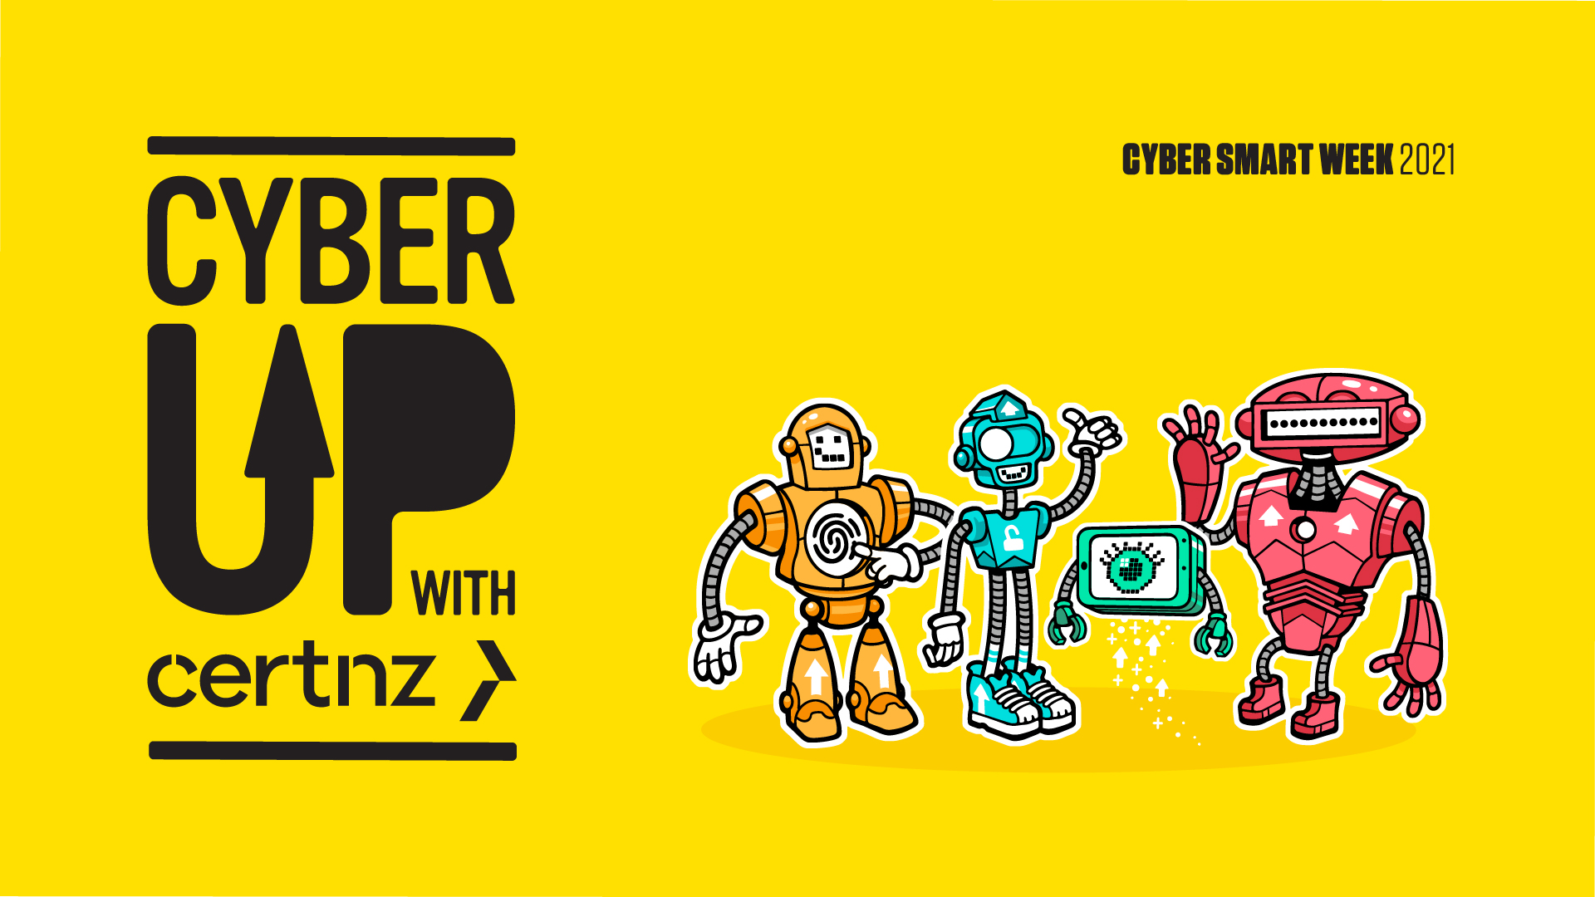
Cyber Smart Pacific 2021
Notes:
Welcome. CERT NZ’s Cyber Smart Week 2021 campaign is empowering all New Zealanders to up their online defences with four simple steps! So let’s Cyber Up!

Slide 2
Who is CERT NZ
Where CERT NZ fits in
What CERT NZ does
How CERT NZ does it
Notes:
CERT NZ works to support businesses, organisations and individuals who are affected (or may be affected) by cyber security incidents. We provide trusted and authoritative information and advice, while also collating a profile of the threat landscape in New Zealand.
The NZ Government set up a new national Computer Emergency Response Team (CERT) as part of Budget 2016. In establishing a CERT, New Zealand joins an international network of CERTs. This improves our access to information on potential or real-time cyber-attacks, and helps us play our part in the global effort to improve cyber security.
CERT NZ’s primary goal is to improve cyber security in New Zealand.
To help achieve their goals, CERT NZ has established 5 key foundation services and functions for CERT NZ.
1. Threat identification: to analyse the international cyber security landscape and will report on threats. CERTNZ gathers information from other national CERTs and high value international security feeds to inform our reports of what’s relevant to New Zealand. Reporting will include advisories and alerts, and other reports where appropriate.
2. Vulnerability identification services: to analyse local data and will report on vulnerabilities. This data includes data sets from CERT NZ info-sharing partners, and unclassified information from NCSC and other agencies. CERT NZ lets organisations know about any vulnerabilities reported to CERT NZ that affect them directly.
3. Incident Reporting Services: to triage reported incidents and assist businesses, organisations and individuals in getting help:
through Cert.govt.nz website, which caters to both specialist and non-specialist audiences, and
by phone. The call centre is available 7am-7pm, Monday to Friday.
CERT NZ also pass some incidents to other appropriate organisations, with the reporter’s consent. For example, reports of online identity theft will be passed to New Zealand Police.
4. Response Coordination Services: to coordinate the response to incidents where the reporter needs to work with several organisations, and will support the national emergency response process.
5. Readiness Support Services: to raise awareness of cyber security impacts and best practice. CERT NZ continues to engage with key info-sharing partners and customers, represent New Zealand in international forums, and deliver up to date, actionable advice on cyber security best practice.
CERT NZ works with other organisations in the cyber security environment across the private, public and not-for-profit sectors in New Zealand.

Slide 3
What are the common threats facing New Zealanders
Phishing and Credential Harvesting
Scams and Fraud
Unauthorised access
Notes:
1,351 incidents were responded to by CERT in Q2 of 2021 with a direct financial loss of $3.9million which is a 30% increase over the previous quarter.
Phishing and credential harvesting made up the majority of these with 618 incidents, Scams and fraud 390, and unauthorised access and malware making up 203 incidents.
These are regularly the top incident categories reported to CERT NZ.
In addition, the number of ransomware reports responded to by CERT NZ has increased by 150% from Q1. (from 12 in Q1, to 30 in Q2)
Why is it increasing? Ransomware attacks are financially motivated. In some instances, ransoms have been paid. This has resulted in an increase of criminal groups carrying out these attacks.
While most ransomware incidents don’t report direct financial loss, the costs of recovery can be significant, and include data loss and operational impact.

Slide 4
Calling everyone to Cyber Up! That means skill up and wise up about cyber security issues, and it’s easily done by following four simple steps to become more cyber secure. Why Cyber Up? Security threats are on the rise with easy-to-target weaknesses in how people set up and maintain passwords, accounts, settings and apps.
Cyber Smart Week 2021
Notes:
CERT NZ’s incident response team have identified the following four simple steps to help combat the majority of cyber security threats New Zealanders face.

Slide 5
How can you Cyber Up?
The 4 steps easy steps you can take:
Upsize your passwords
Upgrade to two-factor authentication
Uphold your privacy settings
Update your apps and devices
Notes:
The theme: CERT NZ’s incident response team have identified the following four simple steps to help combat the majority of cyber security threats New Zealanders face. So up your online defences and Cyber Up!

Slide 6
UPSIZE PASSWORDS
The red robot is all about upsizing your passwords and has a long password in its over-sized head.
Why upsize passwords? To make them harder to crack.
How to upsize? Make them long, strong and unique. And use a password manager to securely store them for you.
Notes:
Make sure your password is long and strong. It can take a attacker only seconds to crack a weak password like Admin123. Protect your personal and financial information with unique passwords that are long and strong.
Make each password different for each account

Slide 7
What makes a strong password
Make passwords long, strong and unique
Use a different password for every online account you have
Make your password long and strong – 12 or more characters. CERT NZ recommends passphrases
Don’t use personal information to create your passwords
Keep them secure in a password manager
Notes:
Use a different password for every online account you have
Make them unique — use each password only once. Many of us use the same password for all our accounts, or stick to two or three different ones that we use over and over. The problem with this is that if an attacker gets hold of one of your account passwords, it'll give them access to any other accounts that share the same password.
Use a different password for every online account. This means if an attacker gets hold of one of your passwords, they can’t get into all your accounts and you only need to change the password on that one account.
Make your passwords long and strong
A long password is a strong password. CERT NZ recommends using a passphrase of four or more words is just as strong as a 10 character password that uses numbers, letters and symbols and easier to remember for example, Robotsgivethebestadvice! This would take millions of years to crack.
Don’t use personal information
Your name, your pet’s name or your partner’s name are password no-no’s –attackers can find this info online, especially through social media. Attackers seek out this information and can use it when trying to guess your password.
Keep them safe
If you’re worried about remembering your passwords, try using a password manager. This will store and manage your passwords for you. The password manager will be the only account you need to remember login details for. And don’t share your passwords with anyone — this includes your partner, your parents and your children.

Slide 8
UPGRADE TO TWO-FACTOR AUTHENTICATION
The orange robot is all about upgrading to two-factor authentication and is represented by a thumbprint on its chest.
Why upgrade to two-factor authentication? To protect with another layer of security.
How to upgrade? Set up an extra login step, like a code sent to your phone or a thumbprint.
Notes:
Enable two-factor authentication (2FA)
That’s two ways of identifying who you are – it’s usually by entering a code from another device on top of your password. 2FA adds an extra line of defence when you log in online.
Even if an attacker knows your password, 2FA is the next layer of security that they’ll need to know to get access to your account. You can use 2FA for most email, social media, banking and shopping accounts, as well as to access your devices.
Every site, app or device does 2FA slightly differently. Look under your account or privacy settings or check the help section. It can also be called ‘two-step authentication’ or ‘multi-factor authentication (MFA)’.
Turn on 2FA for all of your important accounts
Once it’s set up it’s as easy as entering an extra code when you log into a new device.
Keep your phone, device or hardware tokens in a safe place
Treat your device like a password or your keys and keep them safe. Keep using good password practices, such as using unique phrases.
Watch for rogue codes
If you receive a code for an account you weren’t trying to log in to, change your password - someone might be trying to access your account.

Slide 9
Why two-factor authentication?
Upgrading to two-factor authentication (2FA) adds another layer of security to your accounts
Something you know; password or security question
Something you have; physical device, or software
Something you are; fingerprints, voice recognition
Notes:
How 2FA works
When you log into an online account with a username and password, you’re using what’s called single factor authentication. You only need one thing — your password — to verify that you are who you say you are.
With 2FA, you need to provide two things — your password and something else — before you can access an account.
This is often used when trying to reset an account password.

Slide 10
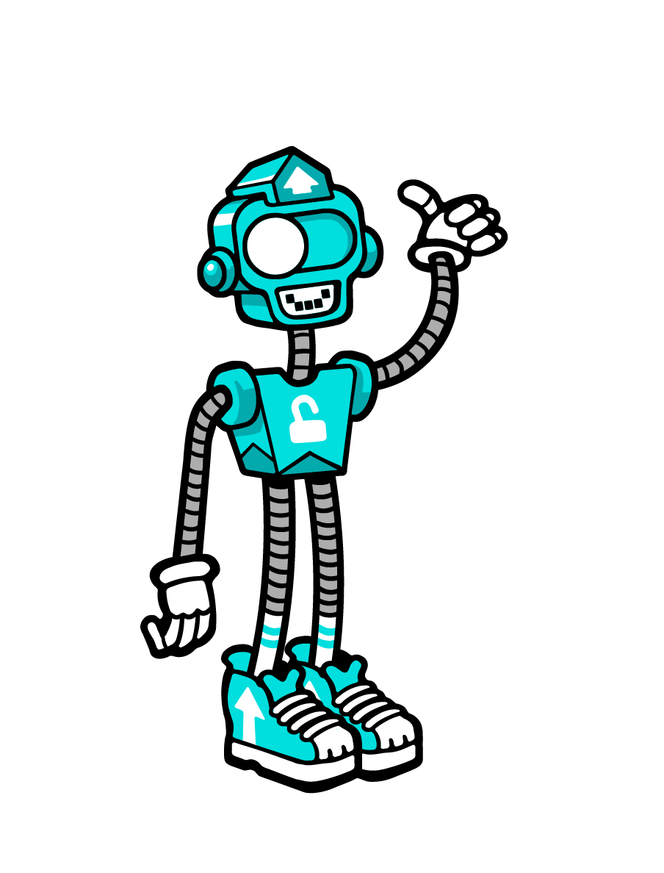
UPHOLD PRIVACY
The blue robot is all about upholding your privacy settings and is represented by a blue slider button on its head.
Why uphold privacy? To control what personal info you share.
How to uphold? Check in settings who can see what, to make sure you know who can see your information.
Notes:
Protect your privacy
What you share on social media could be used by attackers to steal your identity or get into your online accounts. Be careful about who sees what.
Check your privacy settings
On all of your social media accounts, check the privacy controls and set them so only your friends and family can see your details.
Know who your friends are
Only accept friend invitations from people that you know in real life. People can say what they like online, so make sure the people you’re adding as friends really are someone you know personally.
Oversharing much?
Avoid posting too much personal information to your social media accounts. Even if you’ve locked your privacy settings down, it can be tricky to see when your posts have been shared. Most fields on social media are optional — you don’t have to fill them in.
All about me
Some websites ask you to set some account recovery questions in case you forget your password. Make sure the answers to these aren’t posted online or on social media – for example, the school you attended.

Slide 11
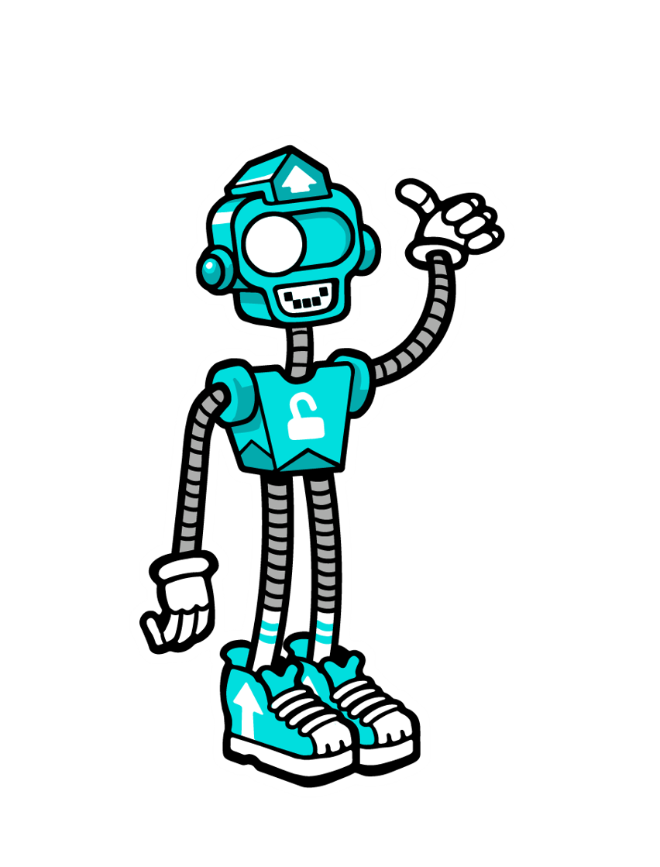
Privacy settings matter
Protecting your privacy online means you have more control over where your personal information goes and who has access to it.
Only share information you need to with companies you trust, when you know who is asking for it and why they need it
Attackers may use your personal info to try and access your private accounts or impersonate you online
Make sure you’re not revealing any personal information, like where your child goes to school
Notes:
We’re so used to sharing things online that we don’t necessarily think about how it affects our privacy anymore. Everyone knows your pet's name, where you went to school, where you work, and even when you’re away on holiday.
Think about who and why you may be asked to share your information
If a company or business asks you for information, think about why they might need it. Do they really need your middle name and phone number? If you’re not sure, don’t provide the information. Why?
The information you share could enable attackers to impersonate you online or even try to steal your identity.

Slide 12
UPDATE DEVICES AND APPS
The green robot is all about updating your devices and apps, and is represented by an eye that animates like a loading symbol.
Why update devices and apps? To keep bugs and viruses out.
How to update? Accept update reminders and giving yourself the best shot with the latest security.
Notes:
Update your operating system (OS)
Cyber threats are changing all the time. Up-to-date operating systems and apps are your first line of defence against many bugs and viruses.
Updates aren’t just about adding new features. They’re also about fixing vulnerabilities and weaknesses in an OS or an app that attackers could use to gain access to your system.
Updating your OS can protect against cyber-attacks
When an update for an app or your OS pops up on any of your devices, install it right away.
Set and forget
Set your system preferences to install updates automatically – then you don’t have to think about it.
Only keep the apps you need
Don’t use it? Delete it. That way it’s easier to keep the apps you use up to date.

Slide 13
Updating your devices
Keeping your software and devices updated is one of the easiest and most effective ways of protecting yourself from a cyber attack.
Update all your devices, including your phone
Update your apps
Delete apps you don’t use - then you won’t need to update them, and you'll free up space on your device.
Don’t forget your smart devices

Slide 14
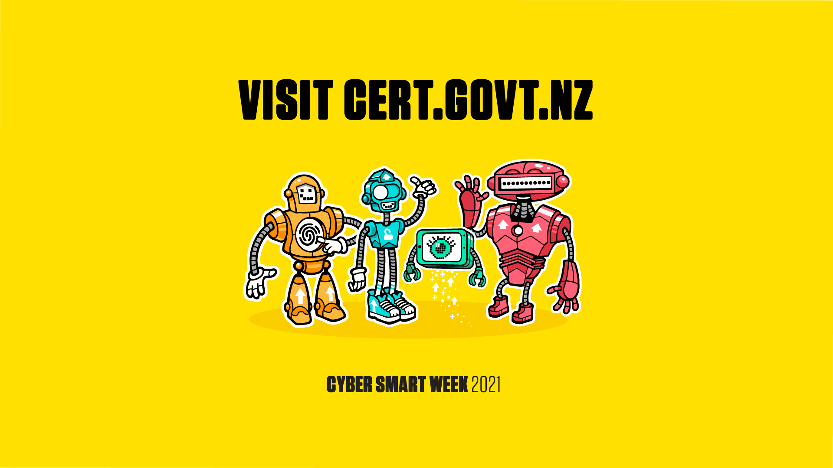

Slide 15
